Slide 1

Bharati Vidyapeeth Deemed University Department of Engineering And Technology Navi Mumbai
INSPENTS
Mr. Rohit Shende (1943110028)
Mr. Indrajit Datar (1943110076)
Mr. Adwait Shinde (1943110070)
Mr. Anurag Gulavane(1943110073)
Guided by Prof. Reshma Kanse

Slide 2
ABSTRACT
Blockchain is a safe distributed ledger system that enables secure and efficient peer-to-peer (P2P) transactions without relying on a central authority.
Cryptocurrencies are a major application of blockchain that requires robust mining algorithms and consensus protocols to validate transactions.
Banks can benefit from blockchain and distributed ledger technology (DLT) to improve efficiency, reduce transaction processing costs, and enhance security and privacy.
Our proposed system aims to design and develop a custom blockchain technology with SHA, mining, and chain consensus algorithm to provide a secure and private banking transaction system.
We also incorporate a secure authentication technique with the help of keylogging secure authentication methodology to enhance the security of our system.
Our system leverages the P2P verification and validation protocols of blockchain to provide secure and private banking transactions.
With our system, users can enjoy faster, more precise, and cost-effective banking transactions while ensuring a strong and secure consensus for every transaction.

Slide 3
INTRODUCTION
A blockchain system may be considered as a simply incorruptible cryptographic database where vital and confidential user’s information will be recorded.
The system is maintained by a network of computers, which is accessible to anyone running the software.
Access control is necessary to manage sensitive user records across multiple premises and devices for heterogeneous users.
Decentralized systems like blockchain are more dependable than centralized ones since there is no single point of attack or failure.
The implementation of the blockchain for secure banking applications includes blocks and transactions, cryptographic algorithms (e.g., SHA, mining, smart contracts, consensus), and data storage and accessibility solutions (e.g., keyword and content-based encryption, Secret Shamir hashing).
The main challenge for blockchain in secure banking applications is to balance security, privacy, scalability, and accessibility.
Within the context of framework for secure banking, a decentralized storage solution would significantly complement the weak point of blockchain within the perspective.

Slide 4
LITERATURE REVIEW
Paper Title | Key Points | Gap Analysis
Inter Bank Payment System on Enterprise Blockchain Platform [5] | Introduces an end-to-end inter-bank payment system based on blockchain using Hyperledger Fabric Enterprise blockchain. - Enables gross settlement, reconciliation, and gridlock resolution facility. | it does not address the potential challenges and limitations of implementing such a system on a large scale, such as regulatory barriers, interoperability issues, and the need for consensus among different banks.
Exploration and Practice of Inter-Bank Application Based on Blockchain [6] | Discusses the difference between traditional transaction structure and blockchain transaction structure. - In a blockchain-based system, participants share a common ledger containing all transactions, whereas in a traditional system, transactions are carried out using a central institution. | It does not fully explore the potential impact of blockchain on the banking industry as a whole, including potential changes to business models, customer expectations, and industry dynamics.
Blockchain Enabled Decentralized Time Banking for a New Social Value System [7] | introduces a time banking system based on exchanging the economy not based on money but value of everyone's contribution on a scale, i.e., time expended. - The blockchain network facilitates members to participate in the service exchange process without depending on a centralized third party for maintaining the service time data. | it does not fully address the potential challenges and limitations of implementing such a system, including issues related to scalability, security, and user adoption

Slide 5
PAPER TITLE | KEY POINTS | GAP ANALYSIS
Blockchain over Transaction System [8] | Discusses issues related to the current banking system such as wavering interest rates, higher security and privacy risks, high cost for maintenance, failures, longer access times to data, and inconsistent performance, etc. - Highlights the benefits of using blockchain technology in the banking sector such as immutable transactions, mass reduction in errors, automation of high volume of data, reduction in turnaround time, audit trail, user management, cross-platform integration, and code independent integrations, etc. | it does not fully address the potential challenges and limitations of implementing such a system, including regulatory barriers, interoperability issues, and the need for consensus among different stakeholders
Enhancing Breeder Document Long-Term Security Using Blockchain Technology [14] | Deals with the efficient document verification system that prevents quantum attacks. - Provides the idea of fingerprint processing and storing data into the blockchain. However, the system takes high computation power and is difficult for poor people to familiarize with this technology. | the paper acknowledges the computational challenges of using fingerprint processing and storing data in the blockchain, but does not propose a feasible solution to address this issue.

Slide 6
RESEARCH GAP
Inter-bank payment systems on blockchain: while existing literature introduces end-to-end systems, they fail to address the challenges of implementing such systems on a large scale, including regulatory barriers and interoperability issues.
Impact of blockchain on the banking industry: while some papers discuss the difference between traditional transaction structures and blockchain-based systems, they do not fully explore the potential impact of blockchain on the industry as a whole, including changes to business models, customer expectations, and industry dynamics.
Time banking systems based on blockchain: while existing literature introduces such systems, they fail to fully address the potential challenges and limitations of implementing them, including scalability, security, and user adoption.
Benefits of using blockchain in the banking sector: while existing literature highlights the benefits of blockchain technology, they fail to fully address the potential challenges and limitations of implementing such systems, including regulatory barriers, interoperability issues, and the need for consensus among different stakeholders.
Enhancing document security using blockchain: while existing literature proposes efficient document verification systems using blockchain, they do not fully address computational challenges and difficulties for users unfamiliar with the technology.

Slide 7
OBJECTIVES
Enhance Security: Blockchain technology can provide a secure and tamper-proof ledger to prevent fraudulent activities and cyber-attacks.
Increase Transparency: Blockchain technology can increase transparency by providing a distributed ledger to record, store, and verify transactions.
Improve Efficiency: Blockchain technology can reduce transaction processing times and costs by eliminating the need for intermediaries.
Reduce Risk: Blockchain technology can reduce the risk of data breaches, fraud, and cybercrimes.
Enhance Trust: Blockchain technology can build trust between customers and banks by providing a transparent and secure transaction environment.

Slide 8
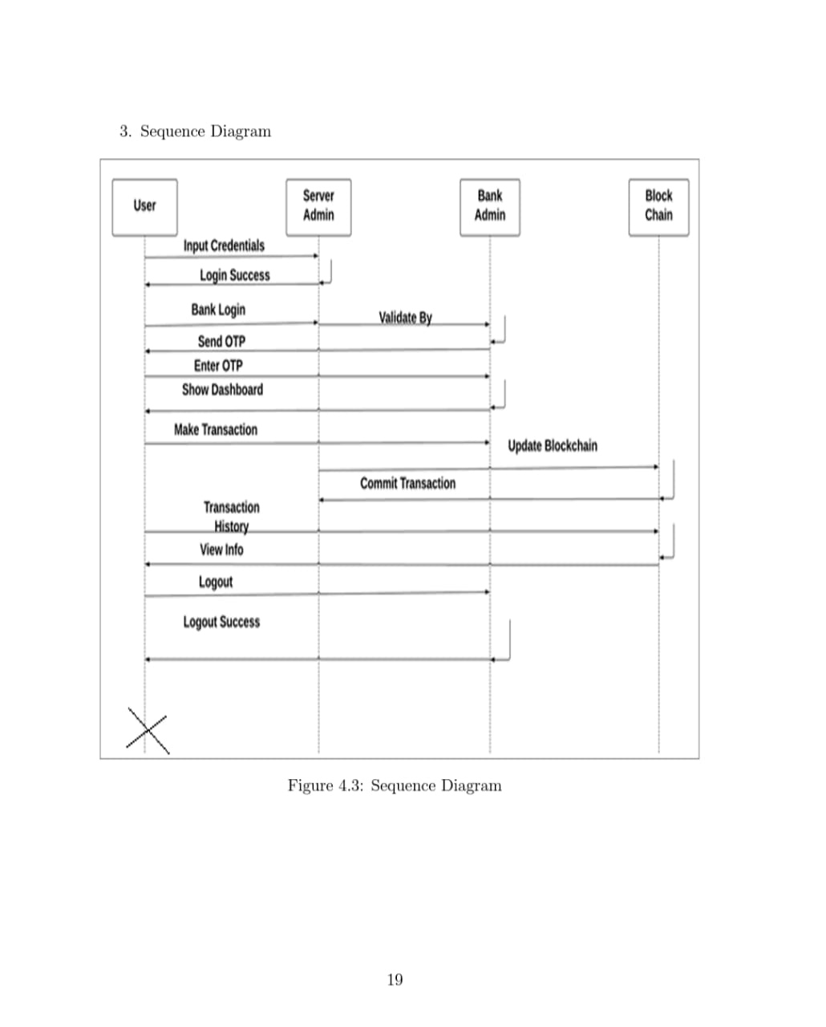
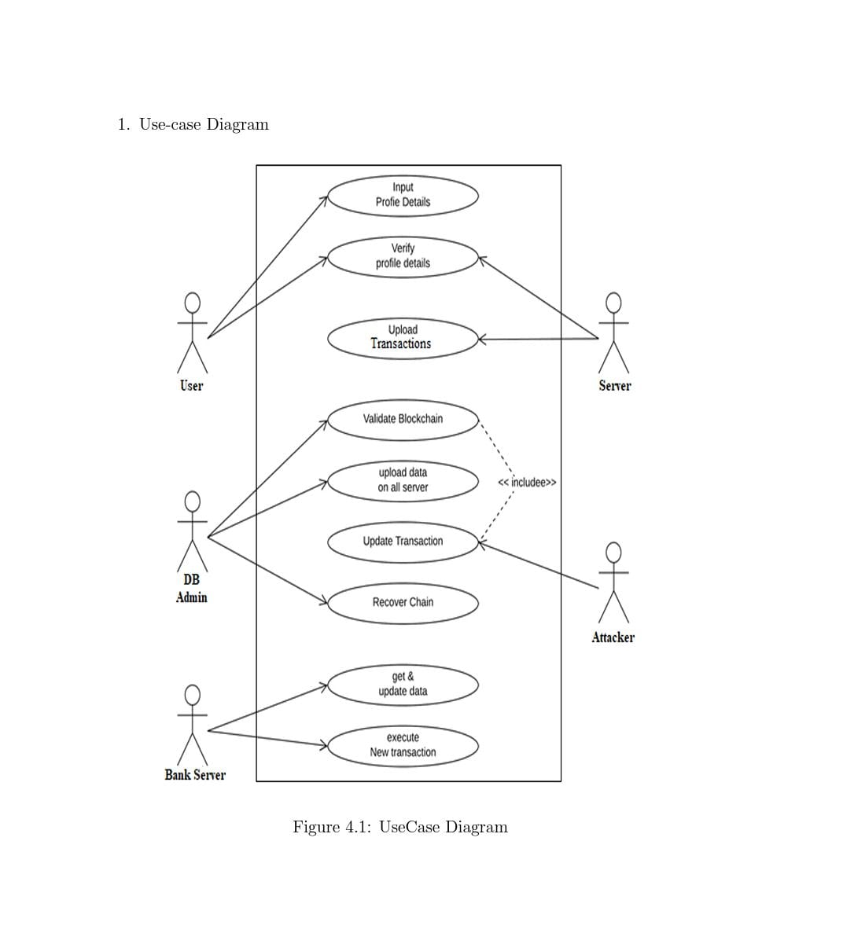
PROPOSED METHOD

Slide 9
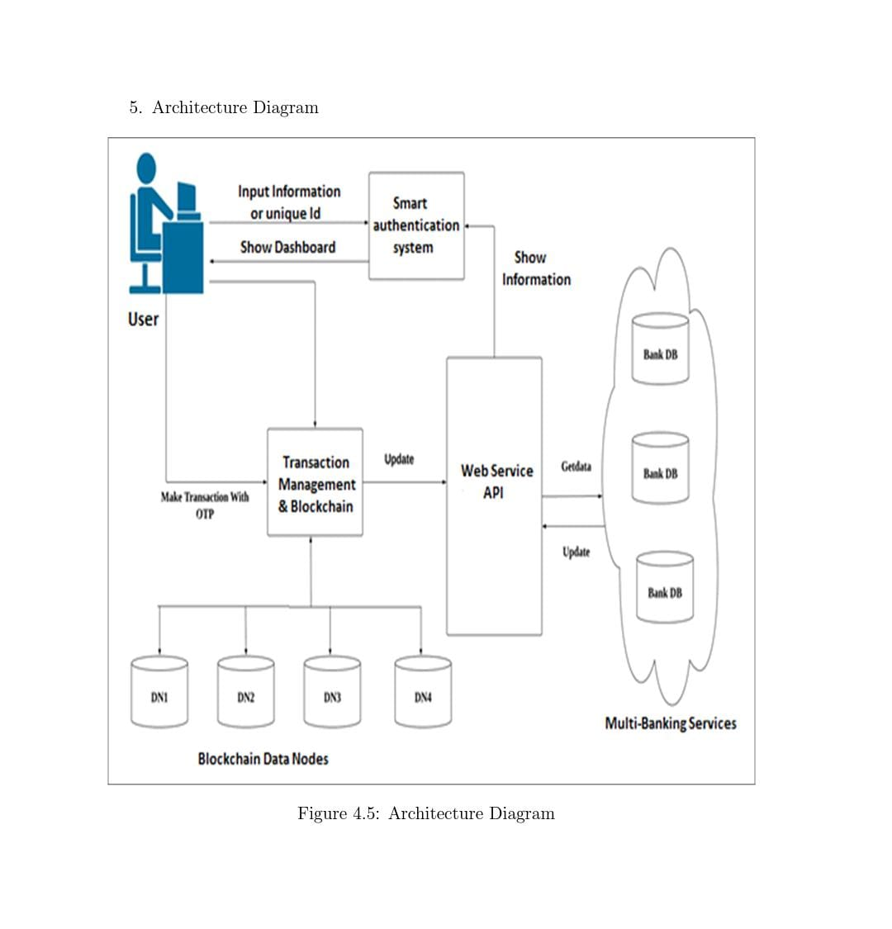
DESIGN METHODOLOGY
All of these solutions rely on creating a unique (custom) blockchain and using it to store all transaction records insecurely. The security of data records can only be guaranteed through the use of a system based on software technology. In order to enhance transaction transparency for end-users, it is important to implement a dynamic smart contract that incorporates a consensus mechanism.

Slide 10
IMPLEMENTATION
1. Design and Architecture:
2. Hyperledger Fabric Setup:
3. Integration with Existing Banking Systems:
4. Smart Contracts Development:
5. User Interface Development:
6. Testing and Deployment:
7. Ongoing Maintenance and Support:

Slide 11
RESULT AND DISCUSSIONS
• Increased Security
• Improved Transparency
• Enhanced Efficiency
• Challenges and Risks
• Business and Regulatory Implications
• Future Outlook

Slide 12
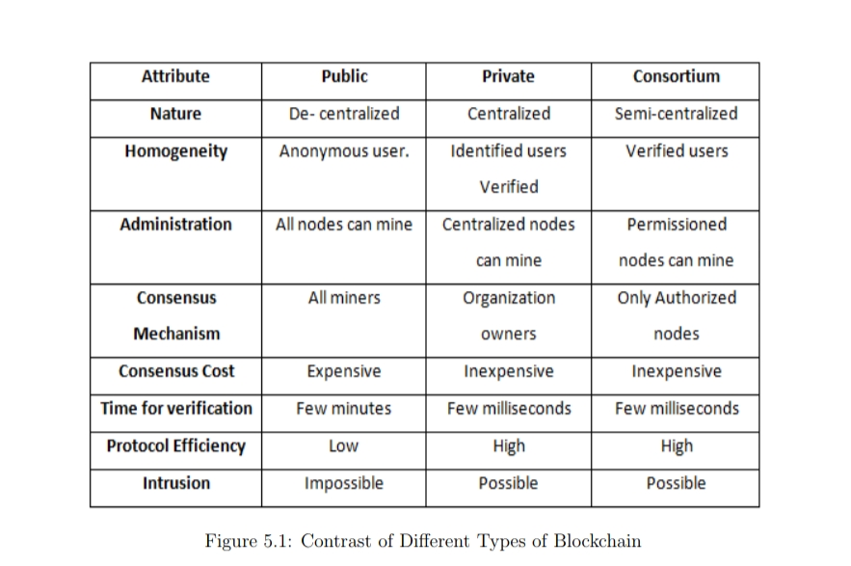

Slide 13
CONCLUSION
In conclusion, a trusted framework for online banking using blockchain technology has the potential to transform the way that online banking services are delivered and consumed. The implementation of a blockchain-based system can enhance security, transparency, and efficiency while reducing the risk of fraud, theft, and cyberattacks. However, the adoption of blockchain technology for online banking also comes with challenges and risks, including regulatory compliance and data privacy concerns. Organizations need to carefully consider these challenges and risks before implementing a blockchain-based system.

Slide 14
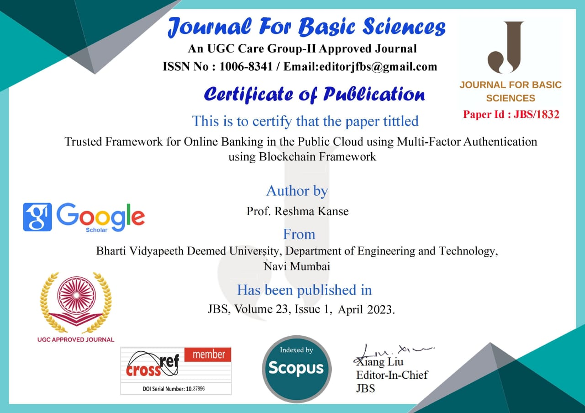
RESEARCH PAPER STATUS

Slide 15
REFERENCES
[1] Sabout Nagaraju and LathaParthiban, “Trusted framework for online banking in public cloud using multi-factor authentication and privacy protection gateway,” Open Access Journal of Cloud Computing: Advances, Systems and Applications (2015)
[2] Dorri, S. S. Kanhere and R. Jurdak, “Blockchain in internet of things: Challenges and Solutions,” arXiv: 1608.05187 [cs], 2019.
[3] Sukhodolskiy, Ilya, and Sergey Zapechnikov. “A blockchain-based access control system for cloud storage.” Young Researchers in Electrical and Electronic Engineering (EICon- Rus), 2018 IEEE Conference of Russian IEEE, 2018.
[4] Yang, Huihui, and Bian Yang. “A Blockchain-based Approach to the Secure Sharing of Healthcare Data.” Proceedings of the Norwegian Information Security Conference. 2020.
[5] Goyal, Vipul, et al. “Attribute-based encryption for fine-grained access control of encrypted data.” Proceedings of the 13th ACM conference on Computer and communications security. Acm, 2006.
[6] Wang, Hao, and Yujiao Song. “Secure cloud-based EHR system using attributebased crypto-system and blockchain.” Journal of medical systems 42.8 (2018): 152.
[7] Michalevsky Y, Joye M. “Decentralized Policy-Hiding Attribute-Based Encryption with Receiver Privacy”.
8] Wu, Axin, et al. “Hidden policy attribute- based data sharing with direct revocation and keyword search in cloud computing.” Sensors 18.7 (2018): 2158.
[9] Khan S, Khan R. “Multiple authorities’ attribute-based verification mechanism for Blockchain micro-grid transactions”. Energies. 2018 May; 11(5):1154.
[10] Guo, Rui, et al. “Secure attribute-based signature scheme with multiple authorities for Blockchain in electronic health records systems.” IEEE Access 776.99 (2018): 1-12.

Slide 16
[11] Monika D. Rokade, Dr. Yogesh Kumar Sharma, “Deep and Machine Learning Approach’s for Anomaly based Intrusion Detection of Imbalanced Network Traffic.” IOSR journal of Engineering (IOSR JEN), ISSN (e): 2250-3021, ISSN(p): 2278-8719 [
[12] Monika D. Rokade, Dr. Yogesh Kumar Sharma, “MLIDS: A Machine Learning Approach for Intrusion Detection for real time Network Dataset.” 2021 International Conference on Engineering Smart Computing and Informatics (ESCI), IEEE.
[13] Monika D. Rokade, Dr. Yogesh Kumar Sharma. (2020) “Identification of Malicious Activity for Network Packet using Deep Learning.” International Journal of Advance Science and Technology, 29(9s), 2324-2331.
[14] S. Nakamoto, “Bitcoin: A Peer-to-Peer Electronic Cash System,” Bitcoin.org, 2008.
[15] D. J. Hwang and K. Lee, “Analysis of security threats and solutions in payment systems,” Information Security Journal: A Global Perspective, vol. 25, no. 2, pp. 50–58, 2016.
[16] T. Dierks and C. Allen, “The TLS Protocol Version 1.3,” Internet Engineering Task Force, 2018.
[17] S. Nakamoto, “Bitcoin: A Peer-to-Peer Electronic Cash System,” Bitcoin.org, 2008.
[18] P. Koshy, D. Koshy, and P. McDaniel, “An Analysis of Anonymity in BitcoINUsing P2P Network Traffic,” in Financial Cryptography and Data Security, 2014, pp. 469–485.Using P2P Network Traffic,” in Financial Cryptography and Data Security, 2014, pp. 469–485.
[19] T. Elgamal, “A Public Key Cryptosystem and a Signature Scheme Based on Discrete Logarithms,” IEEE Transactions on Information Theory, vol. 31, no. 4, pp. 469–472, 1985. [20] D. Boneh and M. Franklin, “Identity-Based Encryption from the Weil Pairing,” SIAM Journal on Computing, vol. 32, no. 3, pp. 586–615, 2003. [21] A. Shamir, “How to Share a Secret,” Communications of the ACM, vol. 22, no. 11, pp. 612–613, 1979.

Slide 17
[20] D. Boneh and M. Franklin, “Identity-Based Encryption from the Weil Pairing,” SIAM Journal on Computing, vol. 32, no. 3, pp. 586–615, 2003. [21] A. Shamir, “How to Share a Secret,” Communications of the ACM, vol. 22, no. 11, pp. 612–613, 1979. [22] A. J. Menezes, P. C. van Oorschot, and S. A. Vanstone, Handbook of Applied Cryptography, CRC Press, 1996.
[23] B. A. Forouzan, Cryptography and Network Security: Principles and Practice, McGraw-Hill Education, 2015.
[24] B. C. Neuman and T. Ts’o, “Kerberos: An Authentication Service for Computer Networks,” IEEE Communications Magazine, vol. 32, no. 9, pp. 33–38, 1994.
[25] J. Salowey et al., “The Secure Sockets Layer (SSL) Protocol Version 3.0,” Internet Engineering Task Force, 1996.
[26] M. C. Rosu, M. Danubianu, and M. V. Rosu, “Blockchain Solutions for the Digital Banking Revolution,” Procedia Economics and Finance, vol. 23, pp. 200–204, 2015. [27] P. Koshy, D. Koshy, and P. McDaniel, “An Analysis of Anonymity in Bitcoin Using P2P Network Traffic,” in Financial Cryptography and Data Security, 2014, pp. 469–485.
[28] V. Buterin, “Ethereum: A Next-Generation Smart Contract and Decentralized Application Platform,” Ethereum.org, 2014.
[29] D. J. Hwang and K. Lee, “Analysis of security threats and solutions in payment 30 systems,” Information Security Journal: A Global Perspective, vol. 25, no. 2, pp. 50–58, 2016.
[30] C. N. Chuang, Y. C. Liao, and Y. C. Chen, “A Privacy-Preserving Cloud-Based Electronic Health Record System Based on Blockchain Technology,” Journal of Medical Systems, vol. 42, no. 8, p. 139, 2018.

